Slide 1
Lecture 23 - Subclasses and Inheritance
subclasses, and inheritance
Kok-Seng Wong | 2021

Slide 2

Motivation example
Child inheriting certain traits from their parent.
[source]

Slide 3
Learning outcomes
Upon the completion of this lecture, students will be able to:
describe the important of inheritance in object-oriented programming.
implement inheritance in Python by using subclasses and overriding superclass methods.

Slide 4
inheritance
inheritance: a process by which one class takes on the attributes and methods of another.
parent classes (or base classes): the classes that child classes are derived from.
child classes (or subclasses): newly formed classes that can override or extend the attributes and methods of parent classes.
Inheritance allows us to define a class that inherits all the properties and methods from another class

Slide 5
Inheritance example
Base Class
Vehicle
Car
Bus
Truck
Derived Class
The derived classes (car, bus, and truck) have inherited all the features of parent class (vehicle)
In the derived class, extra features (e.g., methods) can be added.
Also, it can override the data members and methods from the parent.

Slide 6
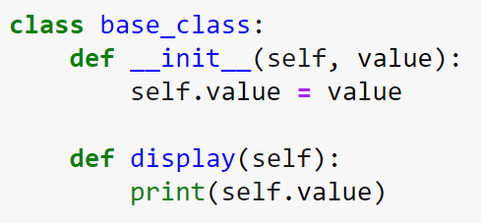




Inheritance: creating parent class
Any class can be a base class for other classes.
Creating an object and calling the method in the base class:
REVIEW

Slide 7
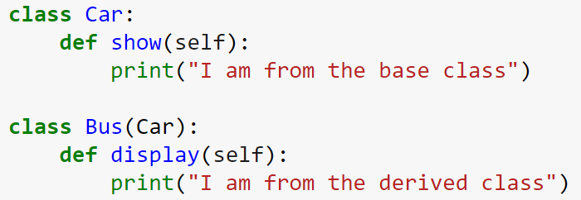
Inheritance: creating Child class
Class <derived_class>(<base_class>):
#Body of the derived class
Also known as Super Class
Also known as Sub-Class

Slide 8
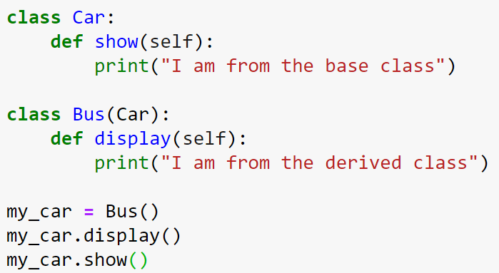

Simple inheritance example
Method from the base Class

Slide 9

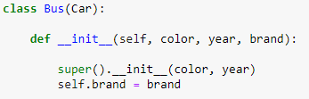
Invoking __init__ of the base class
<base_class>.__init__(self)
super(): returns a temporary object of the superclass.

Slide 10
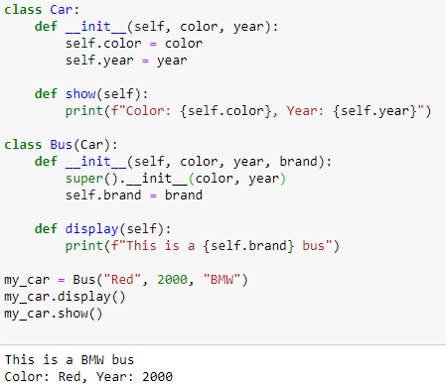
invoking the __init__ of the base class

Slide 11
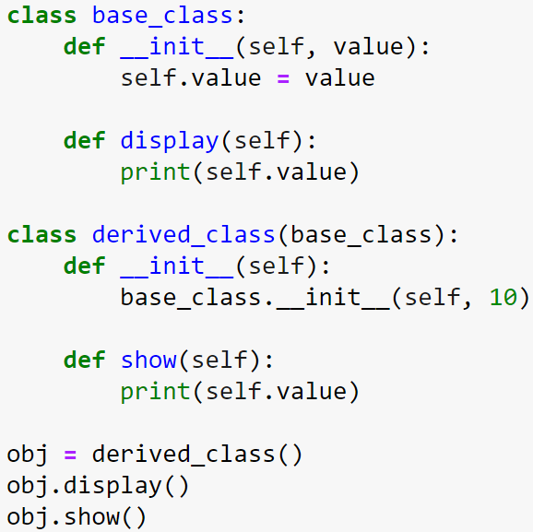

Class practice
Inherited / subclass
invoking the __init__ of the base class
Initialize the value

Slide 12
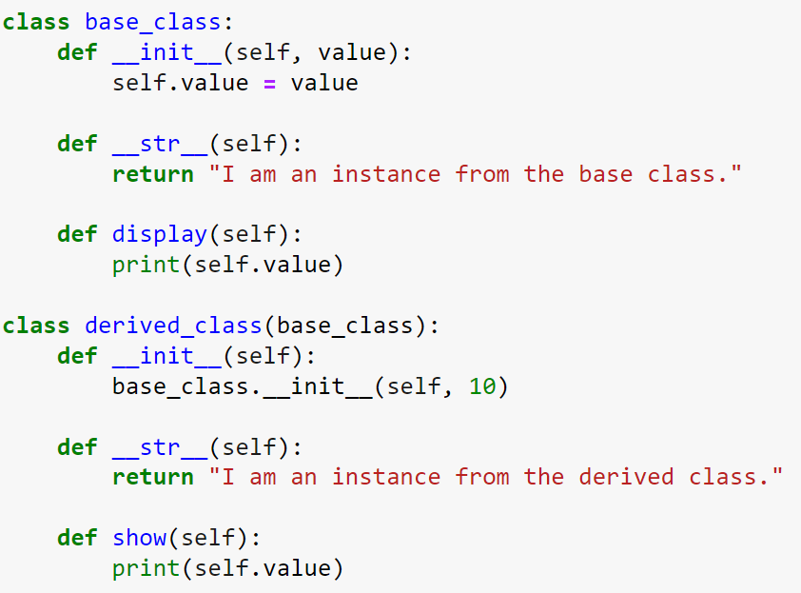
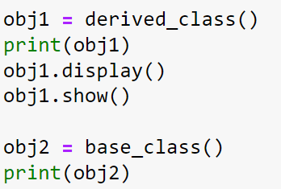

Slide 13
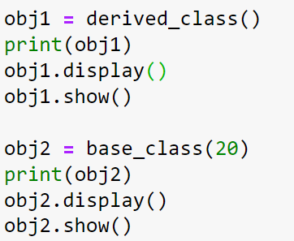

Slide 14
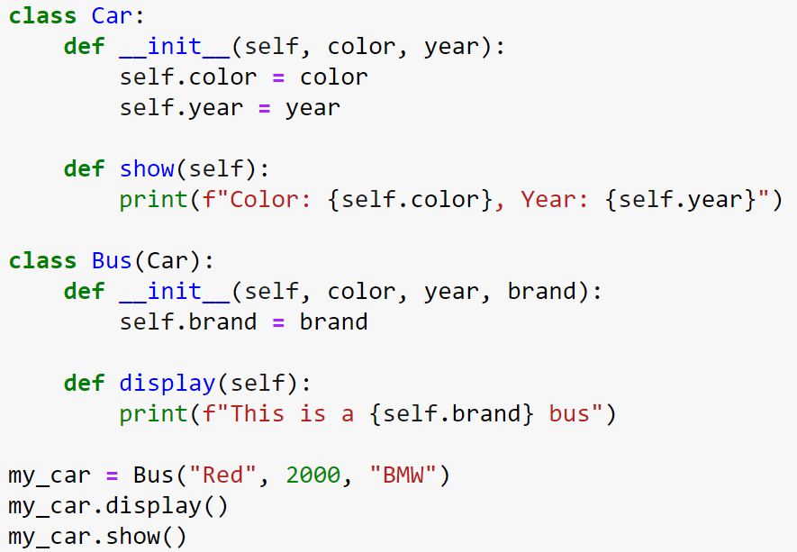
Identify the possible error(s)!

Slide 15
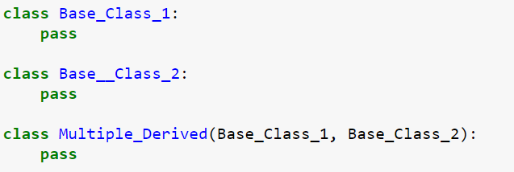
Multiple inheritance
Multiple inheritance: a class is derived from more than one base class.
The properties and methods of all the base classes are inherited into the derived class.
Syntax:
Base_Class_1
Base_Class_2
Multiple_Derived

Slide 16
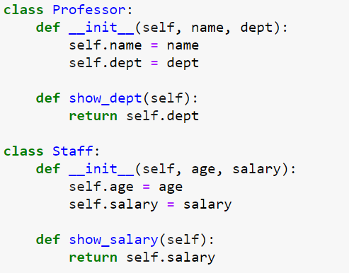
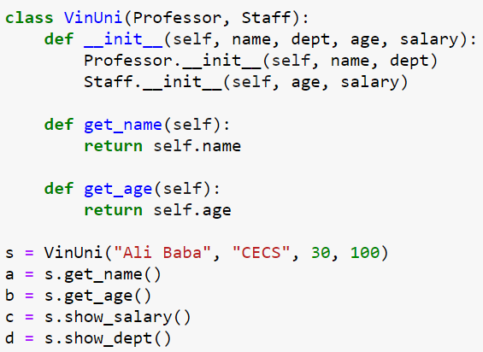
Multiple inheritance example
Output?

Slide 17
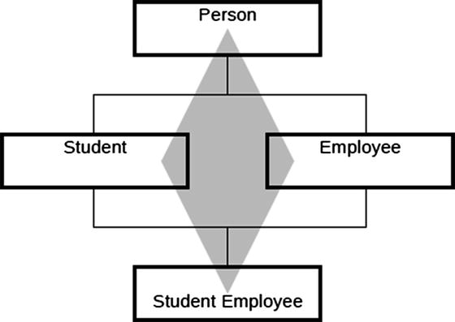
Multiple Inheritance Diamond problem
Also known as “Deadly Diamond of Death”.
When two classes B and C inherit from class A, and class D inherits from both B and C.
Why it is bad?
[source]

Slide 18
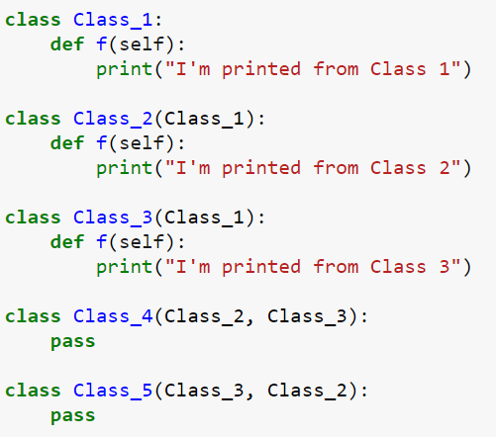
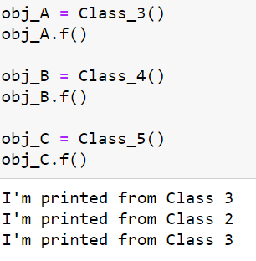
Diamond problem example 1

Slide 19
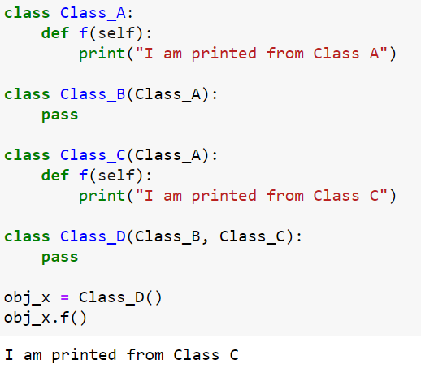
Diamond problem example 2

Slide 20
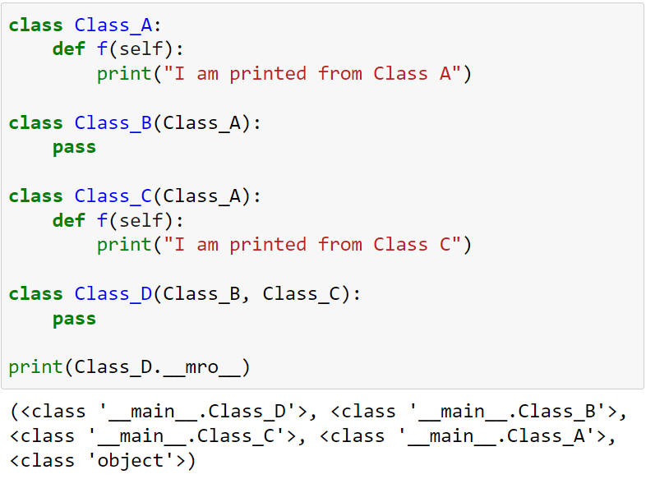
Method resolution order (Mro)

Slide 21
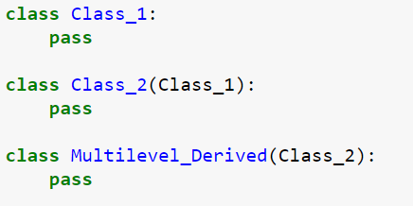
Multilevel inheritance
Multilevel inheritance: a class is derived from more than one base class.
The properties and methods of the base class and the derived class are inherited into the new derived class.
Syntax:
Class_1
Class_2
Multilevel_Derived

Slide 22
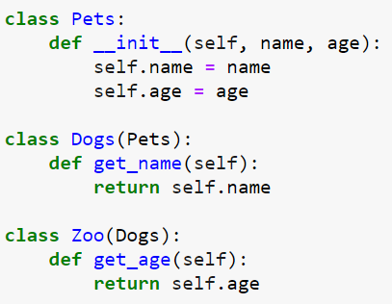
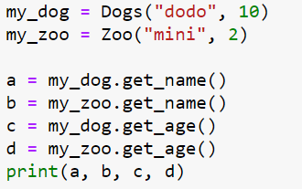
Multilevel inheritance example
Output?

Slide 23


Checking the relationship
issubclass(): used to check class inheritance
isinstance(): used to check instance of class

Slide 24
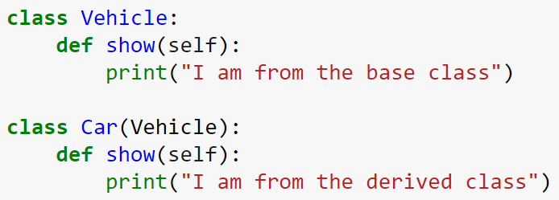



Overriding methods (next lecture)
Overriding: to change the functional operation of a method defined in the base class.
The base class method is overridden by the derived class method.
Base Class
Derived Class

